Slide 1


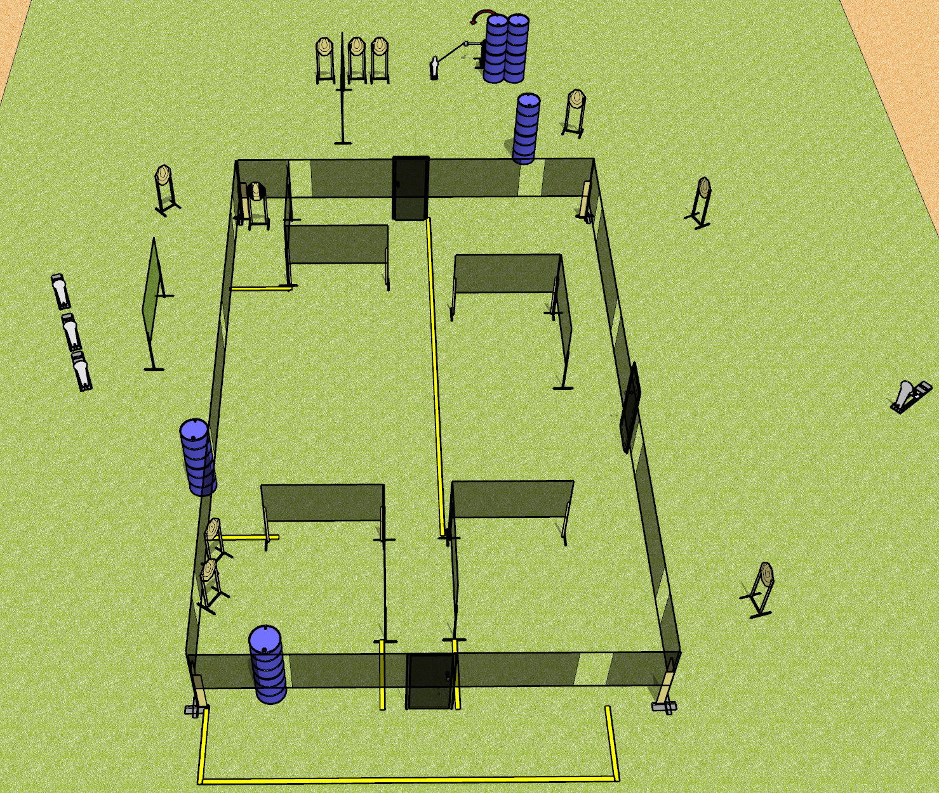
 | Dothan Gun Club – USPSA Match No More House Puns Course Designer : Drew Coleman
Round Count 27 rounds 11 IPSC 4 Colts, 1 mini
Equipment List 2 wall feet Swinger + Activator 1 tux, 10 targets

Slide 2
No More House Puns
Written Stage Briefing
No More House Puns is a 27 round, 135 point, Comstock course of fire. There are 11 IPSC targets and 5 steel. The best 2 hits on cardboard will score and steel must fall to score.
Handgun start position is anywhere inside the shooting area, wrists below belt. Handgun is loaded and holstered.
PCC start position is anywhere inside the shooting area, stock on belt. Loaded carbine is held with both hands, safety on.
On the audible start signal, engage targets as they become available from within the shooting area.

